Slide 1
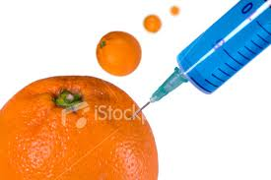
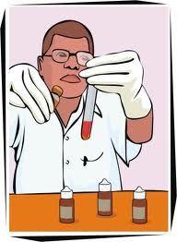
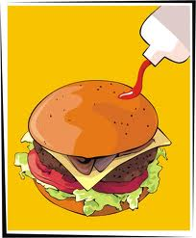
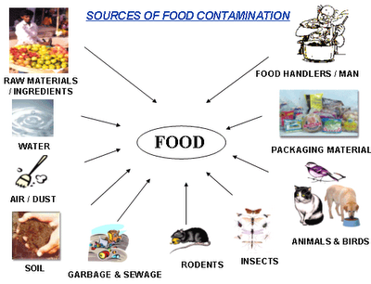
Food Adulteration

Slide 2
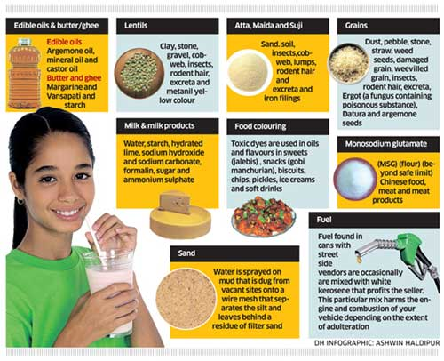

Slide 3
Food Adulteration
Definition: It is an act of
intentionally debasing the quality of food
offered for sale
either by the admixture /substitution of
inferior subs or
by removal of
some valuable ingredients.

Slide 4
When is food said to be adulterated ?
Inferior or cheap sub is substituted .
Constituent is wholly or partly abstracted.
Article is prepared , packed or kept under insanitary condition.
If there is rotten , decomposed or insects in the material.
If it contains poisonous ingredient or diseased animals
Unprescribed colored substance.
Any prohibited or excessive preservative.
If the standard is not maintained.

Slide 5
Who does this and why?
Merchants and traders to make quick profit.
Shortage and increasing prices
Consumer demands
Lack of awareness
Indifference and lethargy among consumers
Enforcement of food laws.
Food adulterated is dangerous as it affects the health ,it may be toxic and deprive from essential nutrients.

Slide 6
Types of Adulteration
Intentional : Added deliberately to increase the margin of profit.
Incidental Intentional adulteration : Adulteration is bec of negligence, ignorance or lack of proper facilities.
E.g. larvae in food, dropping of indents , pesticide residue .
Prevention: Regular market surveys , Using safer pesticides like synthetic pyrethroids , washing vegs before cooking, teaching farmers to use pesticides .

Slide 7
Food - Intentional | Adulterant | Detection
Milk | Water | Pure milk will stop or flow slowly Adulterated milk will flow immediately when dropped on vertical surface
Milk | Urea | 5ml milk in test tube ,add 2 drops of bromothymol blue solution . Blue color will indicate presence of urea in 10 mins
Mustard seeds | Argemone seeds | Argemone has rough surface ,white and mustard has yellow inside
Ice-cream | Washing Pd | Lemon juice ,bubbles are observed
Sugar | Chalk | Dissolve sugar in glass of water, Chalk settles down
Silver foil | Aluminum foil | Silver foil burns on ignition leaving white spherical ball ,aluminum is reduced to black grey ash
Honey | water | Cotton wick dipped in honey burns ,water will not burn and gives cracking sound.

Slide 8
Food - Intentional | Adulterant | Detection
Coffee | Chicory seeds , Tamarind seed powder | Sprinkle coffee pd on water ,it will float while chicory will settle down in few sec
Tea | Colored leaves Iron fillings Used tea | Rub leaves on white paper , artificial color comes out. Use magnet it will stick Sprinkle tea on wet filter ,red spots will be seen.
Red chilly pd | Radamine Brick pd | 2 gm in 5 ml acetone , red color will be seen. It settles faster in water than chilli pd
Turmeric pd | Metanil yellow | Few drops of HCL –appears violet
Dal | Metanil yellow | Luke warm water add pulses and drop of HCL,pink color indicates presence of Metanil
Pure Ghee | Vanaspathi | 1 tsp melted ghee to conc HCL and add pinch of cane sugar-shake well and keep for 5mins,crimson color in lower layer is seen
Black pepper | Papaya seeds | Float in alcohol, pepper will sink and papaya will float
Common salt | White pd stone | Spoon of salt in water ,chalk will give white color and other impurities will settle down

Slide 9
IIA –Incidental Intentional Adulteration | Food involved | Bad effects
Arsenic | Fruits , drinking water | Dizziness,chills,cramps ,
Barium | Food contaminated by rat poison | Muscular twitching
Cadmium | Fruit juice and soft drinks | Liver, kidney damage, multiple facture, cancer
Cobalt | Water , beer | Cardiac failure
Copper | Acid foods | Vomiting,diarrhoea
Lead | Processed food, water | Brain damage, blindness
Mercury | Fish | Brain damage, blindness
Pesticides | All types of food | Damage to liver ,kidney, brain and nerves leading to death.
Antibiotics | Meat | Hardening of arteries , heart disease

Slide 10
Common food adulteration
Argemone seeds: mixed with mustard seeds.
Toxic in form of oil and seeds
As it contains 2 alkaloids obtained from poppy plants .
Closely resembles mustard seeds but surface is rough and uneven and has tail at one end.
Found: Mumbai,Chennai,Bihar,West Bengal
Disease: Beri Beri ,gastro intestinal disturbance , fever,rashes,swelling feet and leg, enlargement of liver, blindness, cancer , cardiac arrest.

Slide 11
Lathyrus (Kesari dal)
Added with other pulses like masoor , black bengal gram ,chana dal,besan, as its staple food for low income people.
Found: Madhya Pradesh , Bihar ,Bengal, Uttar pradesh.
Effect: Paralysis , of lower limbs,stiffness in knee joints ,pain in ankle and knee joints

Slide 12
Toxic Colouring
Colour introduces variety and makes it look attractive and appetizing.
Used; ice cream , dairy products , biscuits, pastries , jelly , custard,
Non permitted color :lead chromate , red ,yellow earth , dyes, peela rang (metanil ),Rhodamine B (red)
Used : dal , sweet meals like jalebies , laddoos,
halwa, red chillies
Effect: abnormalities of bones ,eyes ,skin ,lungs , ovaries , mental retardation.

Slide 13
Common toxic colours
Metanil Yellow
Orange II
Rhodamine B
Blue VRS
Auramine
Malachite Green
Ice candy,Faluda
Halwa
Red chillie pd and churan
Sweets
Sugar coated saunf/sopari
Coconut

Slide 14
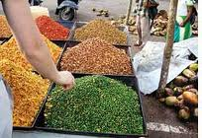
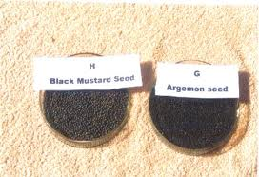
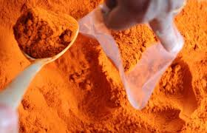
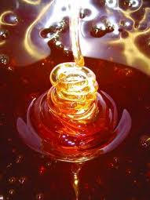
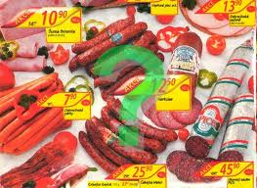
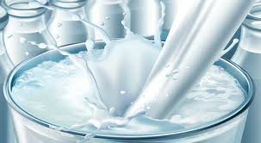

Slide 15
PFA-Prevention of Food Adulteration-1954
This act prohibits manufacture , sales and distributions of not only adulterated food but also food contaminated with microbes, toxicants and misbranded food.
There are standards specified for pasteurized milk, milk powder ,infant milk food etc.

Slide 16
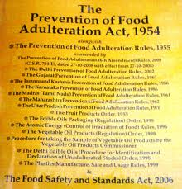

Slide 17
Food shall be deemed to be adulterated
Not up-to standard.
Other subs which affects the quality of the substance.
Inferior or cheap subs used as substitute
Subs has been wholly or partly abstracted
Product has been prepared , packed or kept under unsanitary condition
Poisonous or other ingredient which renders its content injurious to health.
Prohibited preservative added to the product.
Quality or purity falls below the prescribed standard

Slide 18
